Slide 1
Indian Premium Smartphone Market and OnePlus Journey
Author:
Prakash Singh Sijwali

Slide 2
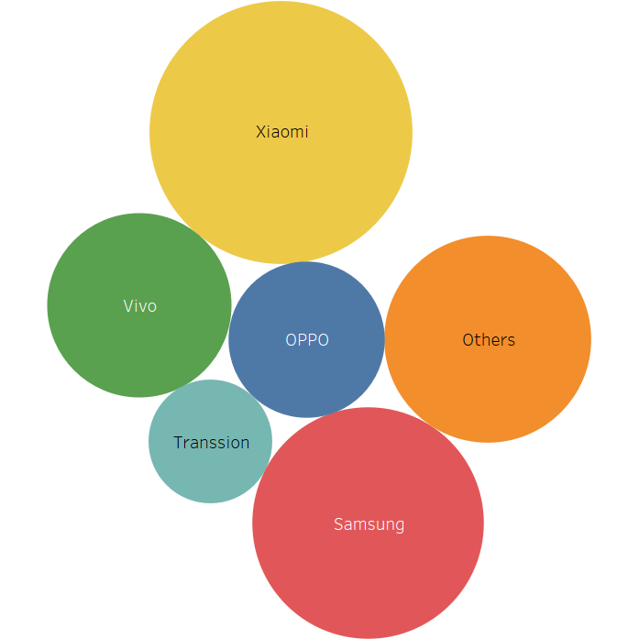
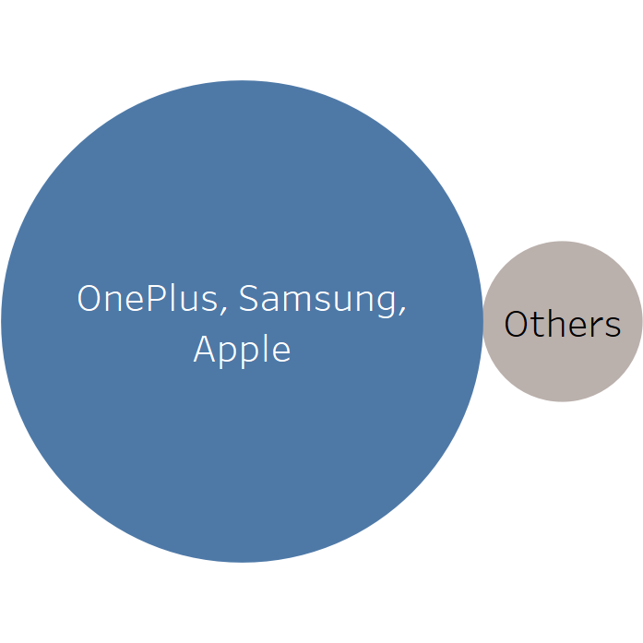
Market Capitalization in Indian Mobile Industry
Premium Segment
https://economictimes.indiatimes.com/tech/hardware/just-2-companies-control-50-of-indias-smartphone-market/articleshow/68007602.cms?from=mdr

Slide 3
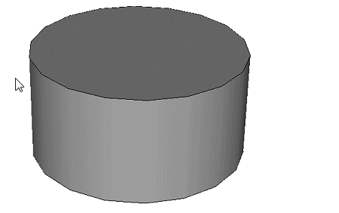
Product Releases
Samsung Note/Edge
iPhone 6/6+
One Plus One
2014
Galaxy s6/edge
iPhone 6s/6s+
One Plus Two/ One Plus X
2015
One Plus Three/ 3T
Galaxy S7/edge
iPhone 7/7+/SE
2016
One Plus 5/ 5T
2017
Galaxy S8/s8+
iPhone X/8/8+
One Plus 6/ 6T/ McLaren
2018
Galaxy S9/S9+
iPhone XS/XS Max/XR
One Plus 7/ 7 Pro
2019
Galaxy S10/S10+
To Be unveiled
https://gadgets.ndtv.com/mobiles

Slide 4
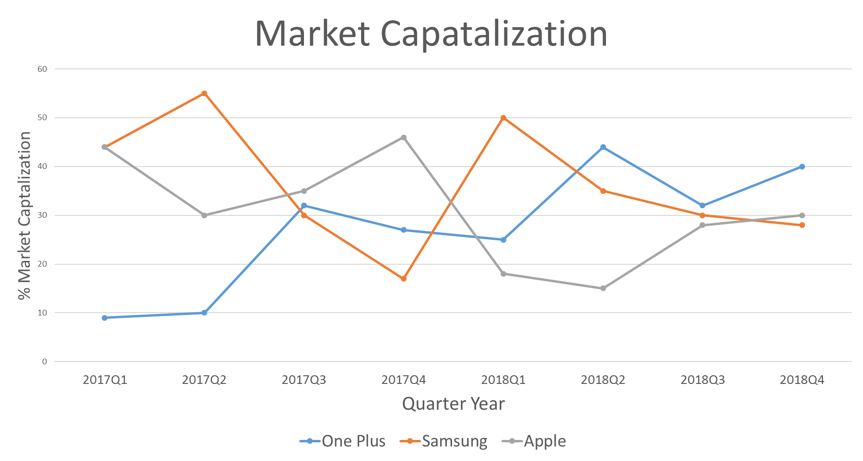
Market Share 2017-2018
https://www.counterpointresearch.com/samsung-led-india-premium-market-2018-oneplus-led-q4-2018/

Slide 5


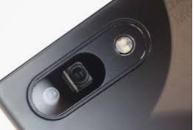
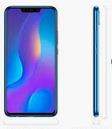
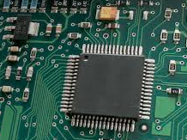
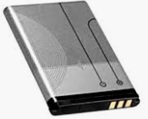
Product Comparison – OnePlus6 V/S Samsung S9
Features
One Plus 6
Samsung S9
Screen Size
Resolution
6.28" (15.95 cm)
1080 x 2280 pixels
5.8" (14.73 cm)
1440 x 2960 pixels
Camera – Rear
Camera – front
Image Resolution
16 MP + 20 MP
16 MP
4616 x 3464 Pixels
12 MP
8 MP
4000 x 3000 Pixels
Thickness
Weight
7.7 mm
177 grams
8.5 mm
163 grams
RAM
Storage
6 GB
64 GB Non Expandable
4 GB
64 GB Expandable -400GB
Battery Capacity
Battery Type
Quick Charging?
3300 mAh
Li-Polymer
Yes
3000 mAh
Li-ion
Yes
Price
INR 34,999
INR 57,900
https://gadgets.ndtv.com/compare-oneplus-6-4655-vs-samsung-galaxy-s9-4569

Slide 6


Sentiment Analysis Outcome – OP6 v/s Samsung S9
Camera
Brand
Battery
Memory / Speed
Camera
Display
Price – Value for money
Display
Design
Quality/Aesthetics
One Plus 6
Samsung Galaxy S9
Size / Weight
Battery
Signal Issues
Headphone/Speaker
Price – Value for Money?
Quality/ Aesthetics
Memory / Speed

Slide 7
Statistical Analysis
Hypothesis Definition
Result/ p-Value**
Action /Recommendation
1
Collect Data
2
Camera Feature is equally popular for Oneplus and Samsung Galaxy 9
Reject NULL, Camera Feature Require upgrading for Samsung
Formulate and Test Hypothesis
0.016 (<0.05)
3
Battery is equally liked for Oneplus and Samsung Galaxy 9
Reject NULL, Battery require Major upgrading for Samsung
1.26e-7 (~0)
Reject/ Accept Null
4
Memory (RAM) is sufficient for Oneplus and Samsung Galaxy 9
Reject NULL, Memory require Major upgrading for Samsung
Actions
3.89e-7 (~0)
** Significance level of 5% considered for p-test

Slide 8
Market Share 2019
https://www.counterpointresearch.com/indias-premium-smartphone-segment-samsung-regains-pole-position-oneplus-6t-continues-best-seller-q1-2019/

Slide 9
Product Comparison One Plus 7 v/s Samsung S10
Features
One Plus 7
Samsung S10
Screen Size
Resolution
6.41" (16.28 cm)
1080 x 2340 pixels
6.1" (15.49 cm)
1440 x 3040 pixels
Camera – Rear
Camera – front
Image Resolution
48 MP + 5 MP
16 MP
4616 x 3464 Pixels
12 MP +12 MP+16 MP
10 MP
4000 x 3000 Pixels
Thickness
Weight
8.2 mm
182 grams
7.8 mm
157 grams
RAM
Storage
6 GB
128 GB Non Expandable
8 GB
128 GB Expandable -400GB
Battery Capacity
Battery Type
Quick Charging?
3700 mAh
Li-ion
Yes
3400 mAh
Li-ion
Yes
Price
INR 32,999
INR 66,900
https://gadgets.ndtv.com/compare-oneplus-7-12235-vs-samsung-galaxy-s10-8940

Slide 10
Sentiment Analysis Outcome – OP7 v/s Samsung S10
Memory / Speed
Camera
Camera
Brand
Memory /Speed
Display
Battery
Quality/Aesthetics
Price – Value for money
Battery
Display
Design
Price – Value for Money?
One Plus 7
Samsung Galaxy S10
Size / Weight
Customer Support
Packaging and Delivery
Quality/ Aesthetics

Slide 11




Conclusion and Future Model
Future
Model
Conclusion:
Unleashing power of analytics and taking informed decisions at right juncture helped Samsung in gaining the market share by understanding people’s pulse.
OnePlus continued to expand its share mostly by optimizing the cost and maintaining “Value for Money” proposition.
However, one food for thought:
“Has OnePlus purposefully being away from “Budget Market” or they are using “Option to Delay”? “

